Slide 1
Blue Ridge Craft Trails Market Research October 2017

Slide 2
Blue Ridge Craft Trails Research
Research objective: to develop a profile of individuals involved in the arts and crafts sector in the BRNHA region as a means of understanding potential engagement in the Craft Trails initiative.
Online survey administered in October 2017 with the help of BRNHA partner organizations involved in the arts and crafts sector.
256 survey completions received from a variety of different respondents involved in the sector, mostly in WNC.
An additional 84 survey completions using paper surveys distributed during summer BRNHA Craft Trails listening sessions.
In some cases, paper survey questions were different than those administered online, so those responses are reported separately with these results.

Slide 3
Are you an artist or craftsperson?

Slide 4
Does your craftwork provide. . . ?

Slide 5
For individuals, my craftwork provides…

Slide 6
Which of the following describes your affiliation? Please select all that apply.
Other: Individual, woodcrafters, crafts student, Chamber, buyer, Arts Council board member, interested citizen, non-profit art school/gallery/ gift shop, collector, Patterson School Nat’l Historic Dist.

Slide 7
How do you currently generate revenue? Averages by Category

Slide 8
Most of my or my organization’s revenue comes from…
Paper Survey Respondents

Slide 9
Please check any and all that apply to your work or your organization.

Slide 10
Which of the following do you see at the most promising way to increase your sales and income?

Slide 11
Which of the following do you see at the most promising way to increase your sales and income?
Other:
Commissions
All of the above focusing on one on one contact with the customer. Keeping our showroom open.
Spending more time creating things I want to sell.
Local farmers market
Having time to make more items
All of the above
Public events/ Presentations - Roaming Artist
My own local retail gallery, operated co-operatively with 2 other artist friends who work in different mediums, provides by far most of my income. We have been in the same location for 14 years and are consistently open 7 days a week.
Personal referrals and people see my work in galleries and then contact me.

Slide 12
Which of the following do you see at the most promising way to increase your sales and income?
Other (cont’d):
Demonstration of the craft creation on set days and times.
Have done all these, bringing more craft lovers and history to the historical weaving industry we are at.
We have just remodeled and added on to our house for a studio and separate gallery space for visitors.
Retail sales is key. Perhaps also featuring an artist doing their work in a venue that also sells the artist's work.
Online sales, Festival sales, and Studio Visits
If there are too many festivals though, the public loses interest. I don't like to wholesale because it takes a big cut out of my profit.
The items I make would never be viable in a business endeavor. The market is entirely over saturated, and the price that would have to be set, would be non-competitive.

Slide 13
Which of the following do you see at the most promising way to increase your sales and income?
Other (cont’d):
Studio visits and regular open hours for studio work for me. I am semi-retired and don't do shows anymore. But I do have things in craft shops and galleries.
Problem w/raising my prices to meet the % I need to give the studio.
All of the above except festivals so expensive and there are so many in our area that the money spent has gone way down over the past ten years.
I have a steady retirement income, so revenue from my craft work is not critical. At this point in time I am not actively seeking to increase income.
Bartering with professional brokers
I'm not sure as I'm just getting started and am having a very difficult time finding anyone that will show or take my work.
To increase sales for me is through studio and/or gallery since I do not use that venue presently.

Slide 14
Where do most customers who purchase your work or frequent your business reside?

Slide 15
Most people who buy my work/ frequent my business are…

Slide 16
Please select all of the activities below that you engage in as an artist or craftsperson or that you host at your location.

Slide 17
My business or organization is engaged in the following…

Slide 18
Is your studio or gallery open by appointment only, or do you have regular hours of operation?

Slide 19
If your studio or gallery isn’t regularly open to visitors, why not? Please select all that apply.

Slide 20
My business or organization is engaged in the following…

Slide 21
If your studio or gallery isn’t regularly open to visitors, why not? Please select all that apply.
Other:
Just haven’t offered that as option before. It is just me and I have a small studio in my home.
I only have a wheel in my garage. I go to an art school to glaze and fire.
There is very little business in traffic and unnecessary traffic is unwanted. Are craftsmen covered by the "Agritourism Limited Liability Law"?
Working from my home. Hope to have a studio and gallery on the property in the future.
Don't have a gallery.
Location of showroom is 5 miles from studio. Doing craft shows, cant be in two places at once.
I am in a new house and studio is on lower level. The neighborhood doesn’t encourage retail so I am trying to figure out how to navigate this without creating a problem.

Slide 22
If your studio or gallery isn’t regularly open to visitors, why not? Please select all that apply.
Other (cont’d):
I am not a professional artist.
Drop in visitors are always welcome, but I am a one man studio and do my own purchasing and delivery. It all depends what is scheduled for my day if I am in the studio.
As self employed artists, we have to wear all hats. It is too expensive to pay someone to stay in my studio IN CASE a customer comes by. Also, art festivals are 60% of my income, so I have to be out of town.
I would love to see a art/craft trail publication happen. It was successful before. But please, please figure out a way to graciously convey the message to the public that as much as we as artists want to have your visit, we have to ask for an appointment.
Work out of my home... don't want people to come to my home in an upscale neighborhood.
Studio in home so by appointment only.

Slide 23
If your studio or gallery isn’t regularly open to visitors, why not? Please select all that apply.
Other (cont’d):
The opportunity has never arisen. There are no studio tours in South Asheville. And the Southern Highland Craft Guild (of which I'm a member) does not support studio visits.
Private residence
My studio is an 8 x10 bedroom inside my home, I make quilts, when working on abed size quilt there is very little room, I do not want customers in my home it would be an inconvenience to my family. I do not want to have to make my home handicap accessible and I do not want the expense of extra insurance if some should fall or get hurt. I am a member of Southern Highland Craft Guild and their galleries carry my items, they handle sells which allows me more time to be an artist
I have a day job.
Gallery is the forge, I am a blacksmith/ metal artist, teach classes.
Work in a small home space.

Slide 24
If your studio or gallery isn’t regularly open to visitors, why not? Please select all that apply.
Other (cont’d):
My studio is deliberately hidden from visitors and my gallery is always open.
If I'm home at studio I'm open. I have a mini gallery and part of my basement also has a retail space . I just prefer to get a call ahead of time to be sure I'm here ( 90%) I'm usually here but it's nice to make sure I'm not working in my pjs lol ! It happens often as I go check something and get caught up ooops ! Also have a rambunctious Airedale puppy at this time that hasn't calmed down yet . Saying all this but I'm open to unexpected visitors anytime except if I'm at a show or dentist or food shopping etc. I work alone so can't be here 100% of the time yet I'd say 90% someone would find me .
My studio is in my home and I don't want to let strangers in at any time day or night. Safer for me if it's by appointment and then I am prepared and presentable too
Another job
In home studio only
Security

Slide 25
If your studio or gallery isn’t regularly open to visitors, why not? Please select all that apply.
Other (cont’d):
We open by appointment but also once a month special events.
All of the above
We are in a residential location - we will be open if appointments are made. Otherwise, if we had regular gallery hours we would have to hire someone while we are away doing wholesale ,retail shows and travel in general.
Very small space in my home in a residential area.
Never considered it as my studio is in my home. Would love to have opportunity other than Arts Council Open
Studio weekend (last weekend in Sept ) to have an open studio tour promoted by you or other groups
I work from my home not a store front
I have no studio.
Establishing a new more accessible studio at new location. Not open yet.

Slide 26
If your studio or gallery isn’t regularly open to visitors, why not? Please select all that apply.
Other (cont’d):
It's in the lower level of my home and my hours vary. Sometimes I teach classes elsewhere. Sometimes I teach
Classes in my studio.
Our studio is in our home.
Not interested in people coming to my home
Far away from the nearest town with galleries.
Work out of home
We are a Quilt Guild and have little or no retail outlet. We attend several Festivals with our Fundraiser Quilt as a means to raise revenue
I am currently a casual artist & only work at my convenience to make gifts & orders for friends & relatives.
A combination of reasons: concerned about theft and the visitors would interfere with my work schedule.

Slide 27
If your studio or gallery isn’t regularly open to visitors, why not? Please select all that apply.
Other (cont’d):
New to the area and not fully engaged in the arts and crafts community but hoping to do so in the future.
Sell product at local shops on commission, not from my own shop.
I don't have a "proper" studio.
I borrow studio space.
I was part of a gallery that had regular hours but it was not worth the time and effort to continue. I enjoyed the interaction and being part of the community, but it wasn’t self-supporting - my income from other sources had to go into the gallery.
I work out of my home/studio.
Shop is located in home.
I don’t have the money to open a shop.
My private space in my home.

Slide 28
If your studio or gallery isn’t regularly open to visitors, why not? Please select all that apply.
Other (cont’d):
My shop is not suited for opening to visitors. It is a bare bones operation for making items I do not try to sell. I make them for family and friends, as gifts, rather than as products.
Have been Seriously ill for about 18 months. Starting to produce again for the first time in a few years.
Our venues are primarily performing arts. Crafts sold and host exhibits intermittently.
Just haven't done that. Am considering it for the coming year.
I work from my home (writer/photographer) and do not want to open it to strangers.
No studio for myself.
Don’t have the traffic to justify keeping studio open regular hours and it also interferes with production.
Staffing

Slide 29
If your studio or gallery isn’t regularly open to visitors, why not? Please select all that apply.
Other (cont’d):
Location was destroyed by fire. Can't afford another brick and mortar due to slow sales
I sometimes exhibit in a local art guild, and that gallery does have regular hours. I do teach out of my home.
Studio, but on an irregular schedule.
Open for exhibits
Don't have the financial backing to open my own studio.
I am concerned for my safety. My studio is in my home.
Our demonstrations and other classes are offered at specific times. We do not yet have any part of our facility open at regular, daily hours.
Would have to purchase costly insurance.
Space, time and location not convenient. Have fulltime employment so my “in” time is limited and inconsistent.

Slide 30
Please select the categories for which your studio or gallery produces or sells.

Slide 31
Please select the categories for which your studio or gallery produces or sells. (cont’d)

Slide 32
Please select the categories for which your studio or gallery produces or sells. (cont’d)
Other:
Fiber art
Home décor
Puppetry & giant characters
Leather flute bags
CD’s
Flower craft
Weaving
Handmade soaps
Experimental mixed media
Bamboo crafts
Cards
Beaded gourd bowls
Collage
Arts Council that promotes artists
Ukrainian Easter Eggs, writer/illustrator of children’s books
Quilts, dolls and some apparel
Reclaimed wood frames
Drawing
Honey and handcrafted dog biscuits
Gourd art
Farming
Paper and fabric
Woodcarving (caricatures)

Slide 33
Would you be interested in any of the following training opportunities? Please select all that apply.

Slide 34
Would you be interested in any of the following training opportunities? Please select all that apply.
Other:
Agritourism, limited liability law protection
How to take good digital photos
Starting co-op galleries/shops
Business, taxes, etc.
Developing presence in galleries and transitioning to wholesale
Having the area know I’m here and an original artist vs. RADA
Internet marketing
I would be interested but have already taken classes in all of these areas
Convincing people to sign up for classes
How to apply to larger, more well known art shows and exhibitions. How to get into many of our local galleries. I think your org could fill in many areas left by HandMade in America's closing.

Slide 35
Would you be interested in any of the following training opportunities? Please select all that apply.
Other (cont’d):
How to be most effective when selling at the big (Atlanta, Orlando) wholesale gift shows. How to make your booth attractive and impactful. What is helpful to say to encourage a potential customer to buy. Brands and types of portable displays. What to expect in terms of shipping, dryage and other costs in addition to the entry fee for the show. Selling at the show vs. just taking orders (no actual sales at the show). List of companies that make quality, but low cost displays for background, tables. Use of elevation on your table, height of table, how to display so people can interact with crafts and purchase. Business cards vs. brochure-size cards. Giving away free items – are they effective, expected? Do they drive sales? Gimmicks to engage and get people to stop - like spinning a wheel for a prize - are they effective?
Merchandising as it relates to festival booths and work placed in galleries.
I am more interested in learning new techniques, rather than running a business. I am a retiree, and have more than enough business training already.

Slide 36
Would you be interested in any of the following training opportunities? Please select all that apply.
Other (cont’d):
E-commerce, website design and maintenance
Online selling
New venues (at least new to me) where I can present my work, preferably with a lecture or short talk, which is generally how I garner my best sales.
I know I need to get up to date w/ "social media" but am nervous or anxious about jumping in.
Advertising with targeted results
As a craftsperson, I would greatly appreciate any knowledge that would lead to more sales.
How to get started; how to be included with another studio; how to get my work out there to name a few

Slide 37
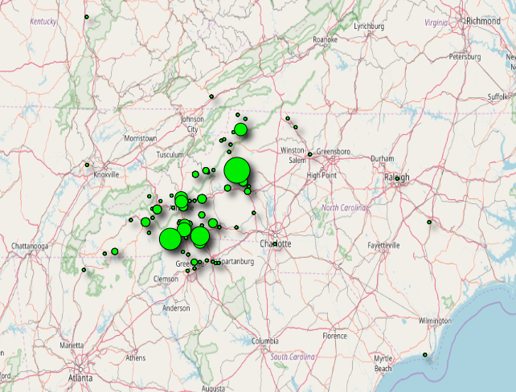
Distribution of Survey Responses
Online Survey Respondents

Slide 38
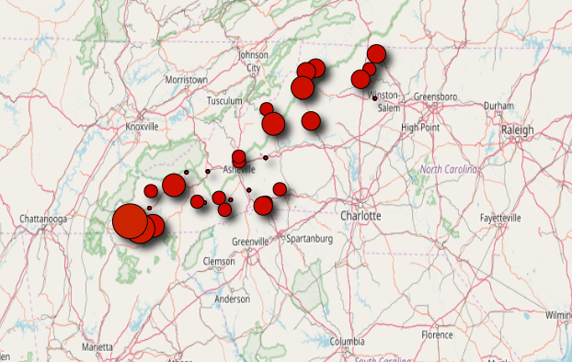
Distribution of Survey Responses
Paper Survey Respondents

Slide 39
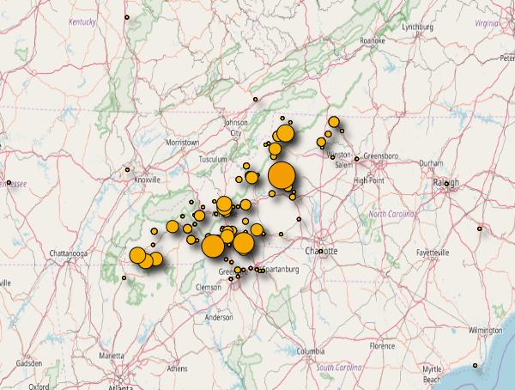
Distribution of Survey Responses
All Respondents

Slide 40
Blue Ridge Craft Trails Market Research October 2017

